Slide 1
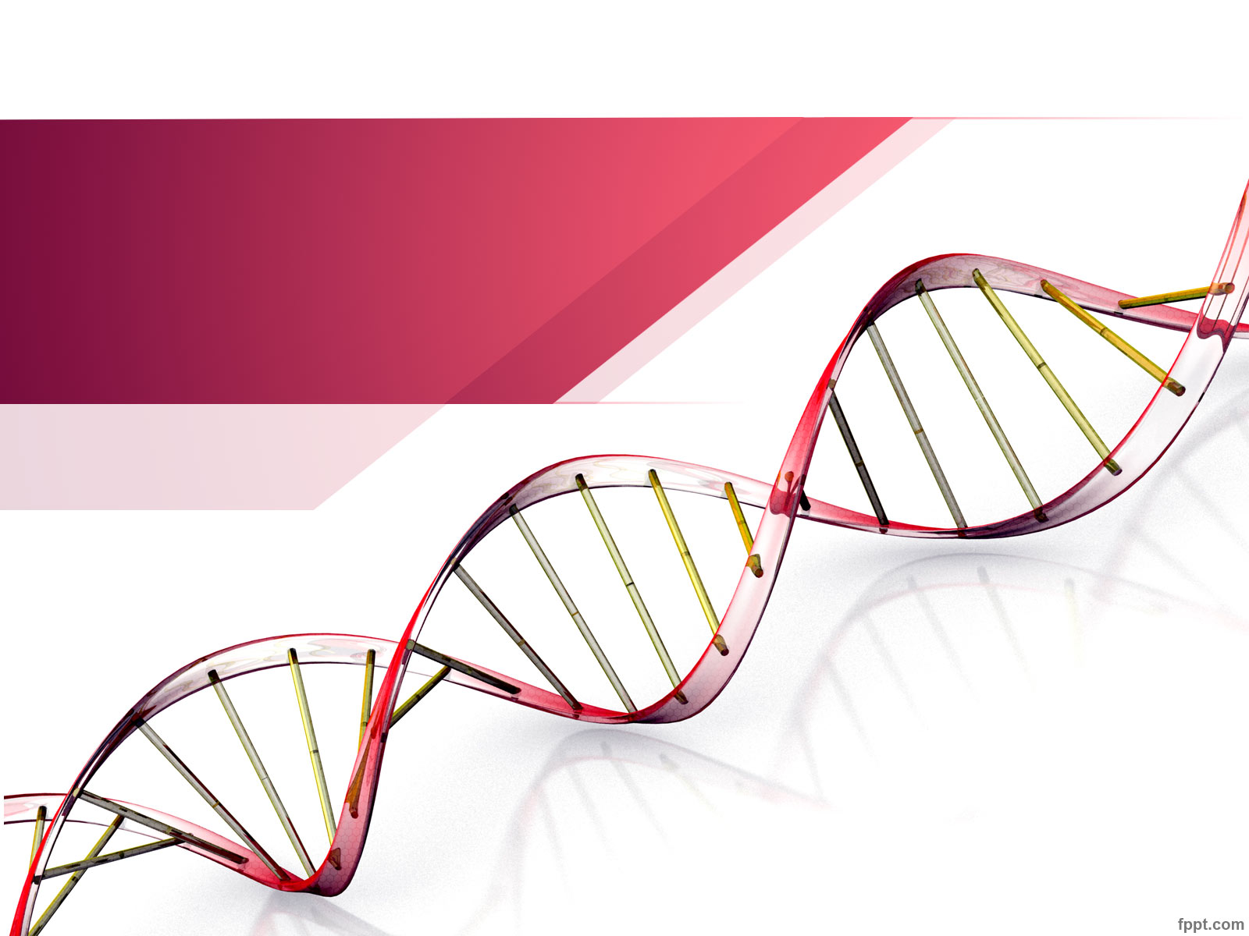
Unraveling our Genealogical
DNA : Class 3
Using Ancestry …
Produced by:
Choctaw County Genealogical Society
Spring of 2018

Slide 2

Agenda:
Were you able to extract your DNA results from Ancestry?
Were you able to import you DNA results into GedMatch?
Chrome Browser
Chrome Browser extension: AncestryDNA Helper
Chrome Browser extension: MedBetterDNA
Emoji’s
Horizontal Cousin List in Excel
Do we need to hold an Excel Class?

Slide 3
Chrome Browser: DNA Tools to help analyze Ancestry results
Install Chrome Browser from Google.com
Install 2 Chrome Extensions (Browser screen\Window\Extensions)
  AncestryDNA Helper
  MedBetterDNA
Notes:
Autosumal DNA provides 5-7 generations DNA matches

Slide 4
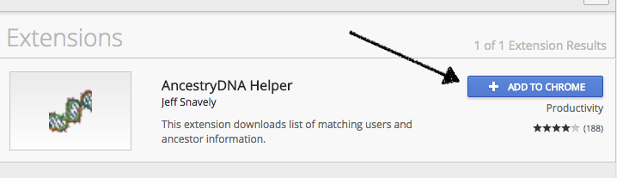
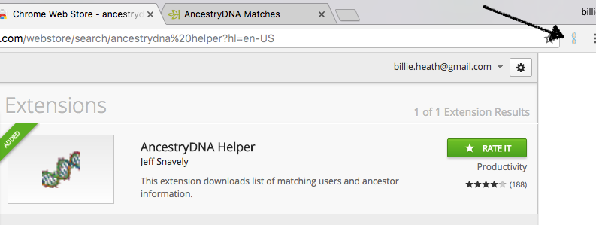
Chrome Extension:
AncestryDNA Helper
Extensions: Browser screen\Window\Extensions
Search for and install: “AncestryDNA Helper”

Slide 5
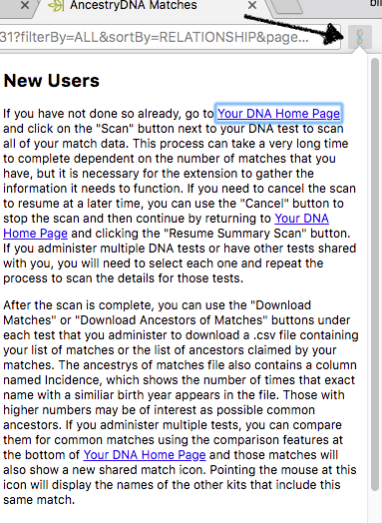
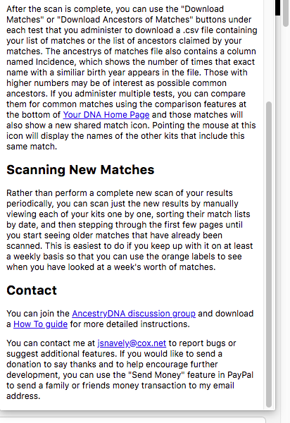
Chrome Extension:
AncestryDNA Helper
Follow instructions, see the new Icon
Notes:
Goals:
Confirm suspected connections, find unknown connections and determine Ethnicity.

Slide 6
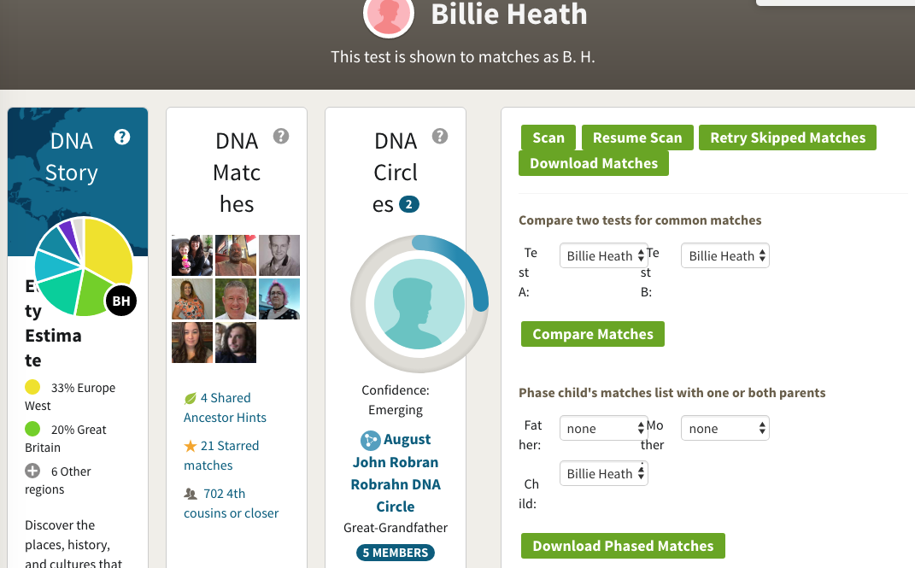
Chrome Extension:
AncestryDNA Helper Results
On Ancestry DNA Home page:
Notes:
Goals:
Confirm suspected connections, find unknown connections and determine Ethnicity.

Slide 7
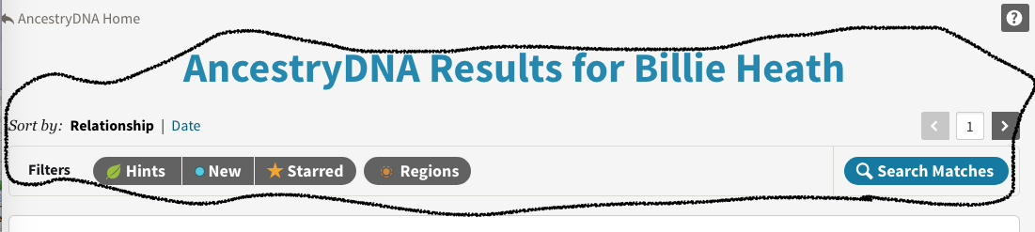
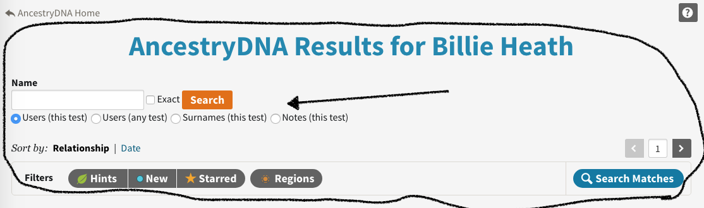
Chrome Extension:
AncestryDNA Helper
Before:
After:
Notes:
Goals:
Confirm suspected connections, find unknown connections and determine Ethnicity.

Slide 8
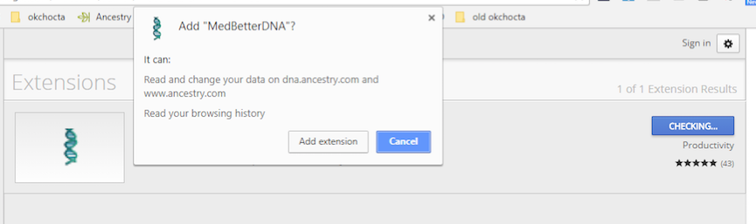
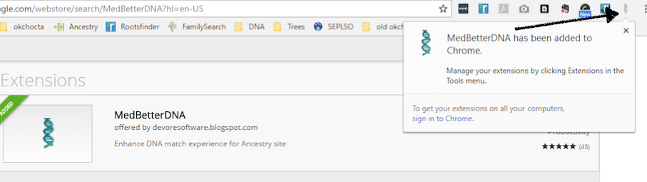
Chrome Extension:
MedBetterDNA
Extensions: Browser screen\Window\Extensions
Search for and install: “MedBetterDNA”

Slide 9
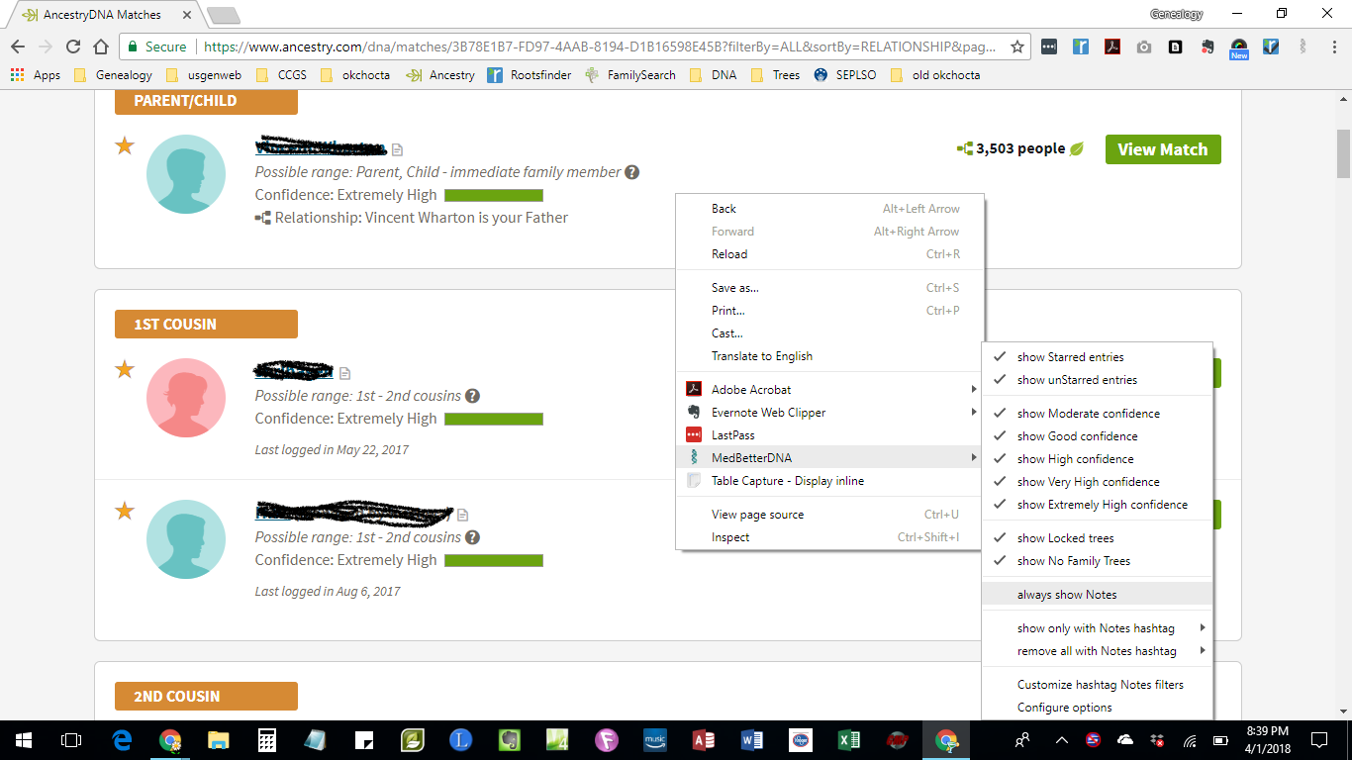
Chrome Extension:
MedBetterDNA: Usage
Notes:
Goals:
Confirm suspected connections, find unknown connections and determine Ethnicity.

Slide 10
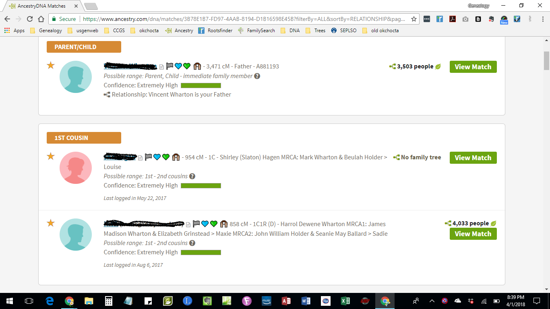
Chrome Extension:
MedBetterDNA: Usage Results
Notes:
Goals:
Confirm suspected connections, find unknown connections and determine Ethnicity.

Slide 11
Emoji’s: Can they help?
Use Emoji symbols to quickly identify family match areas in documents and Ancestry
Give each parent and grandparent a unique Emoji
As you identify where the match is associated with, add their assigned Emoji in the Ancestry Comments area
Emoji’s located at: http://getemoji.com/
Copy & paste where you want the emoji to be

Slide 12
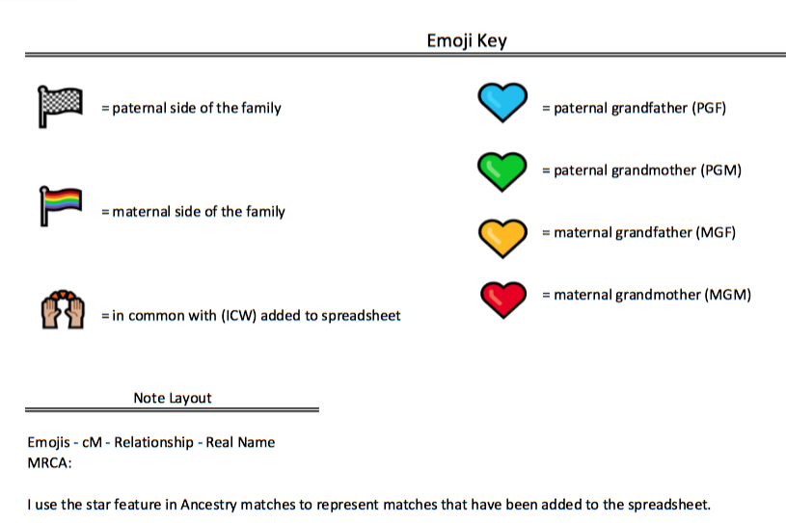
Emoji’s: April’s Key

Slide 13
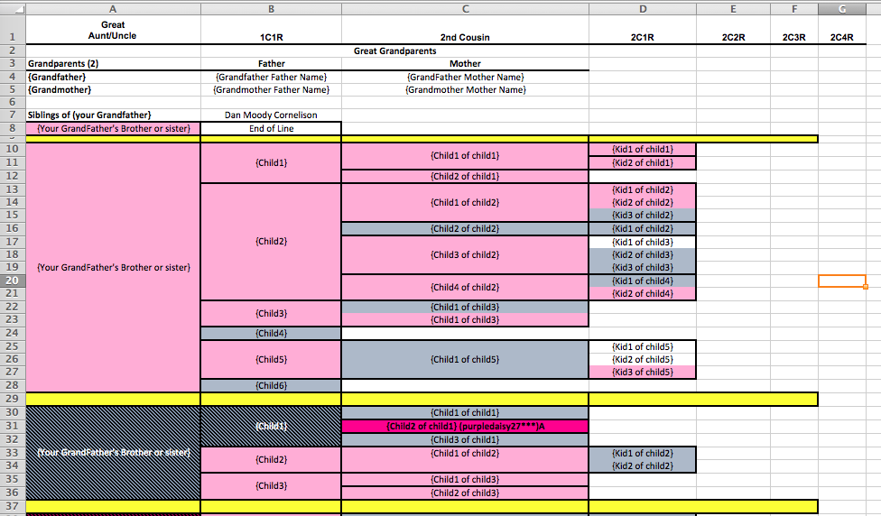
Cousin list: Oh my gosh ….
Identify and track your cousins for DNA matches
See Horizontal Cousin List and handouts

Slide 14
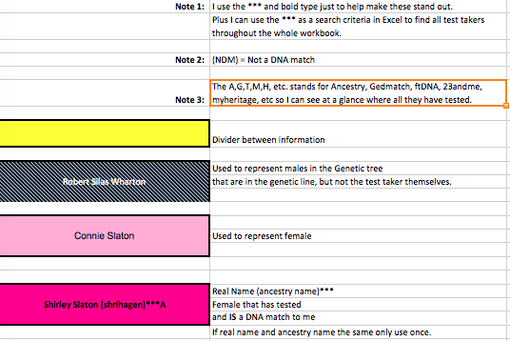
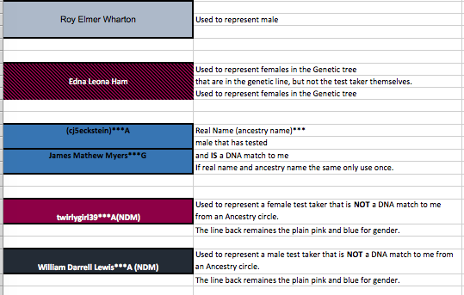
Cousin list: Key Tab …..
To all the colors

Slide 15
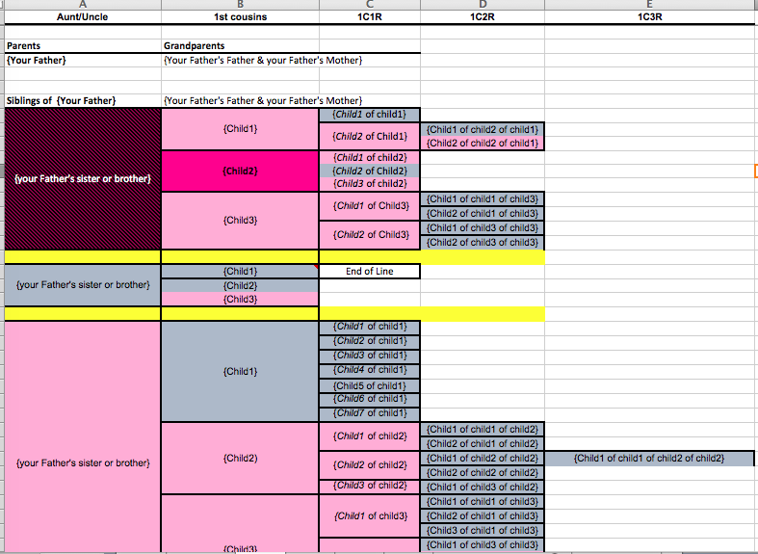
Cousin list: P1 Tab
You father’s line ….

Slide 16
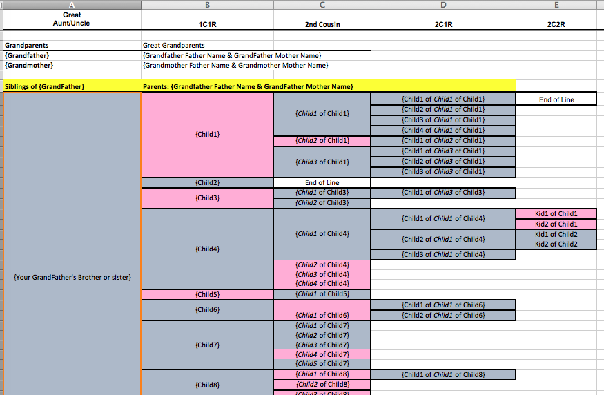
Cousin list: P2 Tab
You father’s line ….

Slide 17
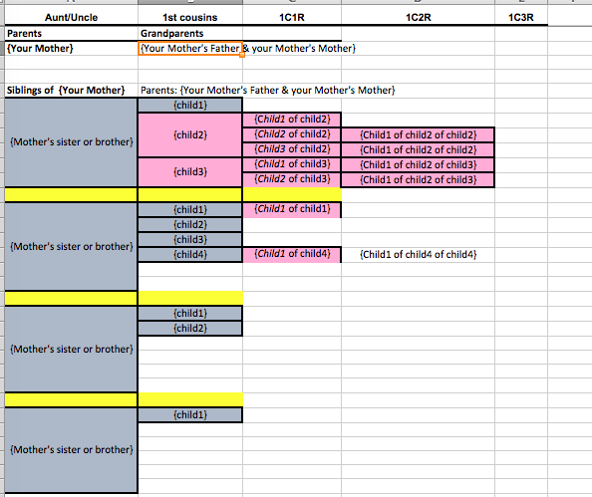
Cousin list: M1 Tab
You mother’s line ….

Slide 18
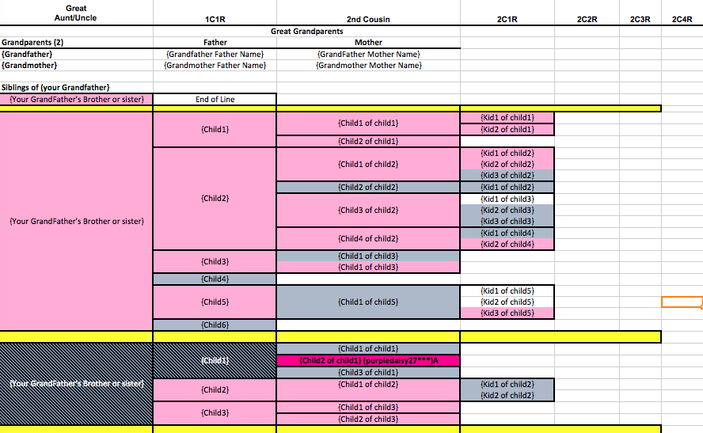
Cousin list: M2 Tab
You mother’s line ….

Slide 19
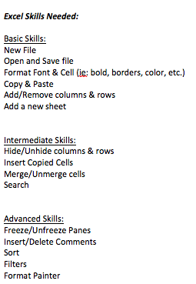
Let’s talk Excel skills ….

Slide 20
In the end …
Recap:
  Use Chrome Browser
  Install Chrome Extensions
  Consider using Emoji’s to code family matches
  Horizontal Cousin List
Next class expectations: How to use your new Ancestry Tools for DNA matches
Fill out Horizontal Cousin List for both sides of your family in Excel
Has the class met your Goal, yet?
Next Class: May 7, 2018

Slide 21
Homework Class 3
Continue working on your Cousin List
Use Ancestry to update the status of the people in your Cousin list, based on your matches.

Slide 22
References:
Emoji’s located at: http://getemoji.com/
DNA Painter https://dnapainter.co

