Slide 1
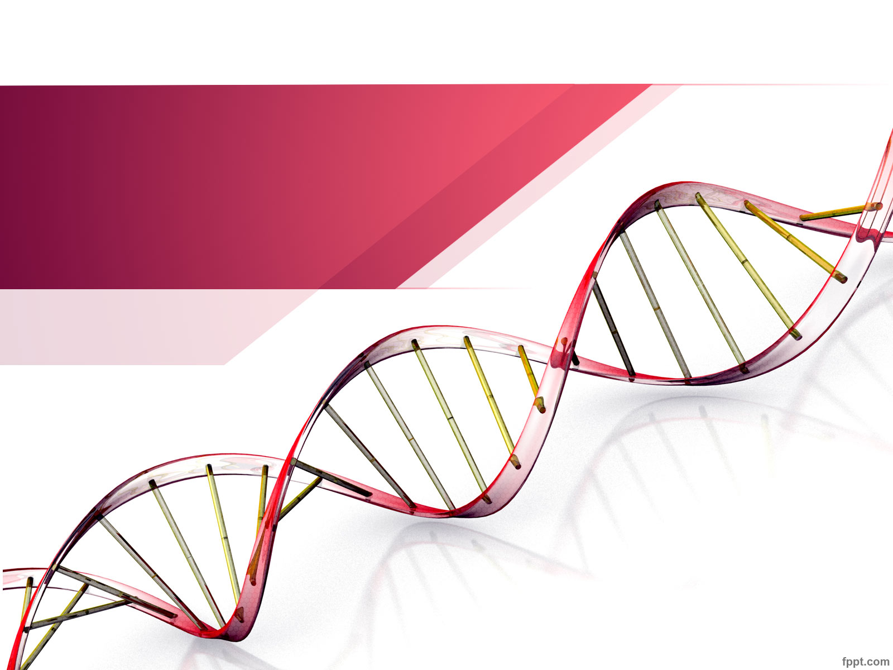
Unraveling our Genealogical DNA: Class 1
Produced by:
Choctaw County Genealogical Society
Spring of 2018

Slide 2
In the beginning …
Description of Class
Class 1: DNA Overview - DNA terms, types of DNA tests and testing companies
Class 2: You’ve tested, now what? - Tips & Techniques on how to work with your matches.
Class 3: DNA Tools – Third party resources that provide tools for additional analysis of your DNA.
Introduce presenters and attendees
What is your Goal? ____________________________________________________________________________________________________
Belongs to: ________________________ Date:___________
Notes:
Description of Class =
Introduce leaders = Billie & April …. Etc
Introduce attendees:
Goals: Confirm suspected connections, find unknown connections and determine Ethnicity. Write goals on a board.
Attendees stating their goal will help focus them and us to meet their needs. Will be used in a recap at the end of Class3.

Slide 3
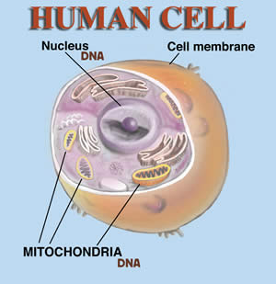
What is DNA?
DNA or deoxyribonucleic acid is the biological matter that carries genetic information.
DNA within a cell
Nucleus
Contains chromosomes 1 – 22 and sex chromosomes
Mitochondria
Notes:
A chromosome is a very long double – helix of DNA found in the nucleus of a cell and organized with proteins; humans have twenty-two pairs of autosomal chromosomes and one pair of sex chromosomes for a total of 46. Half are received from the father and half from the mother.

Slide 4
Types of DNA Tests
Autosomal DNA (atDNA) – tests the twenty-two pairs of chromosomes located within the cell nucleus. Provides genetic information back 5-7 generations on all lines paternal and maternal.
xDNA (included in the atDNA test) - X DNA is the DNA on the X chromosome. Females inherit one X chromosome from their mother and one from their father. Males inherit one X chromosome from their mother and none from their father.
Notes:
Both males and females can test.

Slide 5
Types of DNA Tests
Mitochondrial DNA (mtDNA) – tests the mitochondrial DNA located outside the nucleus. mtDNA passes from a mother to all of her children;
males inherit mtDNA from their mother but do not pass it to their children
females inherit mtDNA from their mother and pass it to both male and female children.
Both males and females can test.
Y DNA (yDNA) – tests the DNA on the Y chromosome. The Y chromosome is the sex chromosome passed from father to son. Only males can test.
Notes:
Definitions of words associated with DNA

Slide 6
Three Main Testing Companies
Ancestry
Ethnicity & Autosomal DNA which provides xDNA
Trees and DNA test/results
23andme
Ethnicity & Autosomal DNA which provides xDNA
Neanderthal and Haplogroup
DNA test/results
Trees import or added summarization
Family Tree DNA
Ethnicity & Autosomal DNA
Mitochondrial sequence
Y DNA test
Accepts results from Ancestry and 23andme for analysis
Gedcom import or link a tree from WikiTree

Slide 7
Up & Coming DNA Companies
MyHeritage.com
Recently started DNA testing
Process of building their Data Base
LivingDNA.com
British based company
Living DNA is a collaboration of over 100 world-leading scientists, academic researchers and genetic experts from across the globe with the purpose of bringing cutting edge DNA technology to the world.
The team is led by DNA Worldwide Group, a leading DNA testing firm. The company is run by David Nicholson and Hannah Morden who saw an opportunity to show humanity that we are all made up of all of us, dissolving the concept of race. It was launched in 2016 after two years of intensive development but its parent company DNA Worldwide Group has been operating since 2004.
Living DNA shows how you can break down someone’s ancestry within the UK

Slide 8
Let’s talk DNA …..
DNA contains 46 Chromosomes
22 Chromosomes from our mother and 22 from our father
Chromosome 23 determines our sex, XX - female and XY - male
Approximately 50% of our DNA comes from our mother and 50 % comes from our father
Siblings do not inherent the same 50%, each will be different
1 -22 Chromosomes determines our ancestry
Daughters receive an exact copy of their fathers X chromosome
Sons receive an exact copy of their fathers Y chromosome
The X chromosome received by both sons and daughters is typically some recombination of the mother’s two X chromosomes.
Notes:
Show video. Then review this page to followup what the video showed.
https://familytreewebinars.com/download.php?webinar_id=480

Slide 9
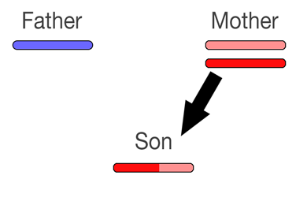
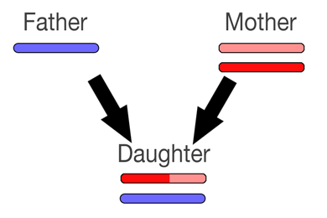
Recombination
A typical recombined X chromosome passed from mother to son and mother to daughter might look like this.
We will look at recombination in more depth in future classes.
Notes:
yDNA
The ‘meat’ of this class.

Slide 10
Homework:
Genealogical Pedigree Chart
DNA Pedigree Chart
xDNA Inheritance Chart for Female
xDNA Inheritance Chart for Male
Recommended videos to watch, see References slide.

Slide 11
In the end …
Recap
Next class expectations
Homework needed for next class
Has the class met your Goal, yet?

Slide 12
Additional References for Class 1:
International Society of Genetic Genealogy: https://isogg.org/wiki/Understanding_genetic_ancestry_testing
Maurice Gleeson YouTube videos:
“Autosomal DNA, how to use it in practice”
Kitty Cooper site and tools:
blog.kittycooper.com/dna-basics/
DNA eXplained Blog: dna-explained.com/
WikiTree: https: www.wikitree.com/
Blaine Bettinger site and tools – thegeneticgenealogist.com/

